Slide 1
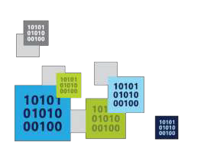
Intro to Bot Framework
Build and connect intelligent bots
Trilok Chowdary
Program Manager
Codepixel

Slide 2
What Are Bots?

Slide 3
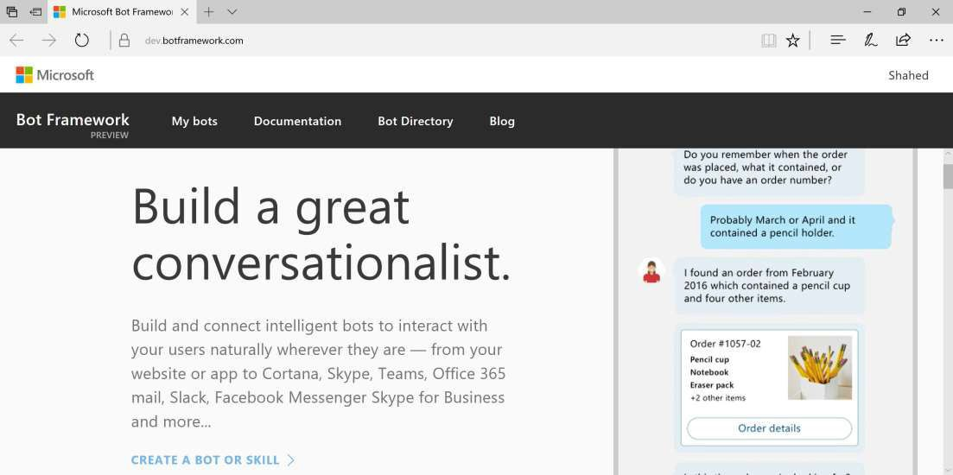
MS Bot Framework
https://dev.botframework.com

Slide 4
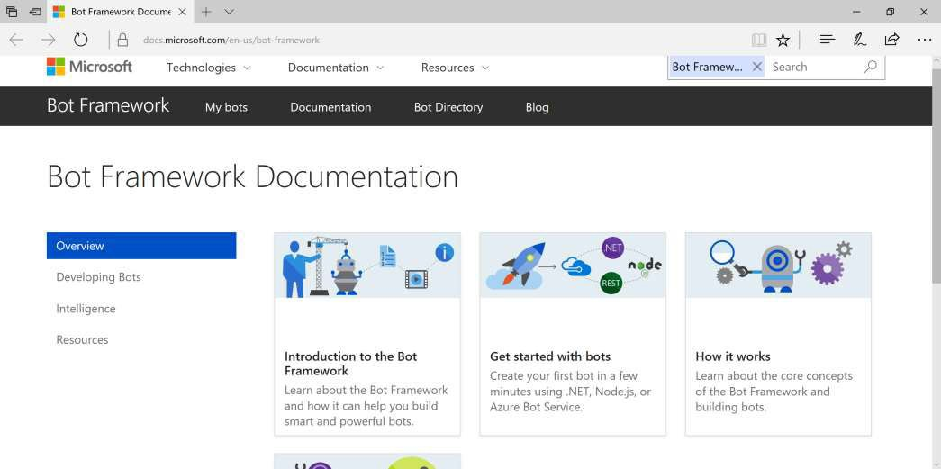
Overview
http://docs.botframework.com
Bot Framework:
Builder SDK
Connector
Dev Portal
Directory

Slide 5
What’s New in V3
BotBuilder + Connector • Starting conversations
= 1 SDK
Message => Activity
ActivityTypes enum
Message properties
Sending replies with
HttpResponseMessage
with 1 user or group
Options => Cards
Bot State service for
user data
Web.config changes
for ID/Password fields
https://docs.microsoft.com/en-us/bot-framework/resources-upgrade-to-v3

Slide 6
Building a Bot

Slide 7
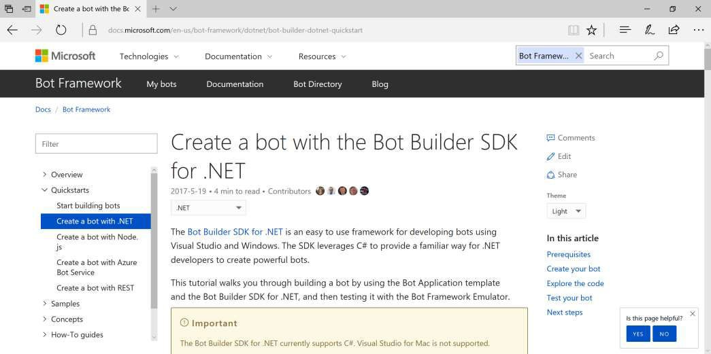
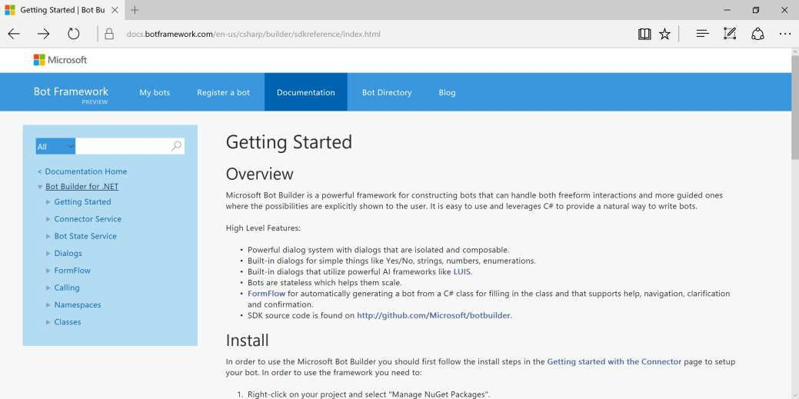
Bot Builder SDK for .NET with C#
https://docs.microsoft.com/en-us/bot-framework/dotnet/bot-builder-dotnet-quickstart

Slide 8
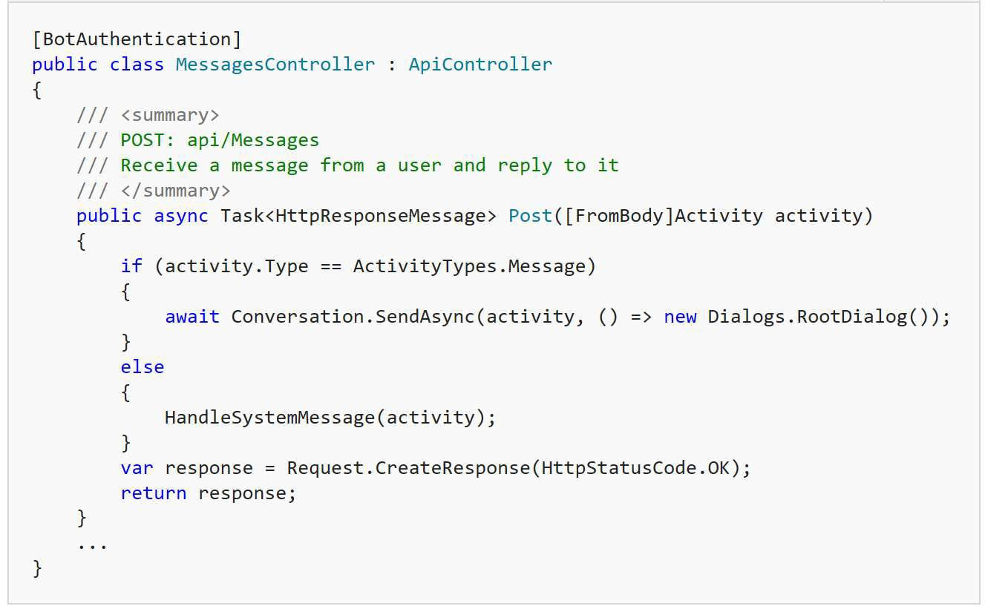
MessagesController

Slide 9
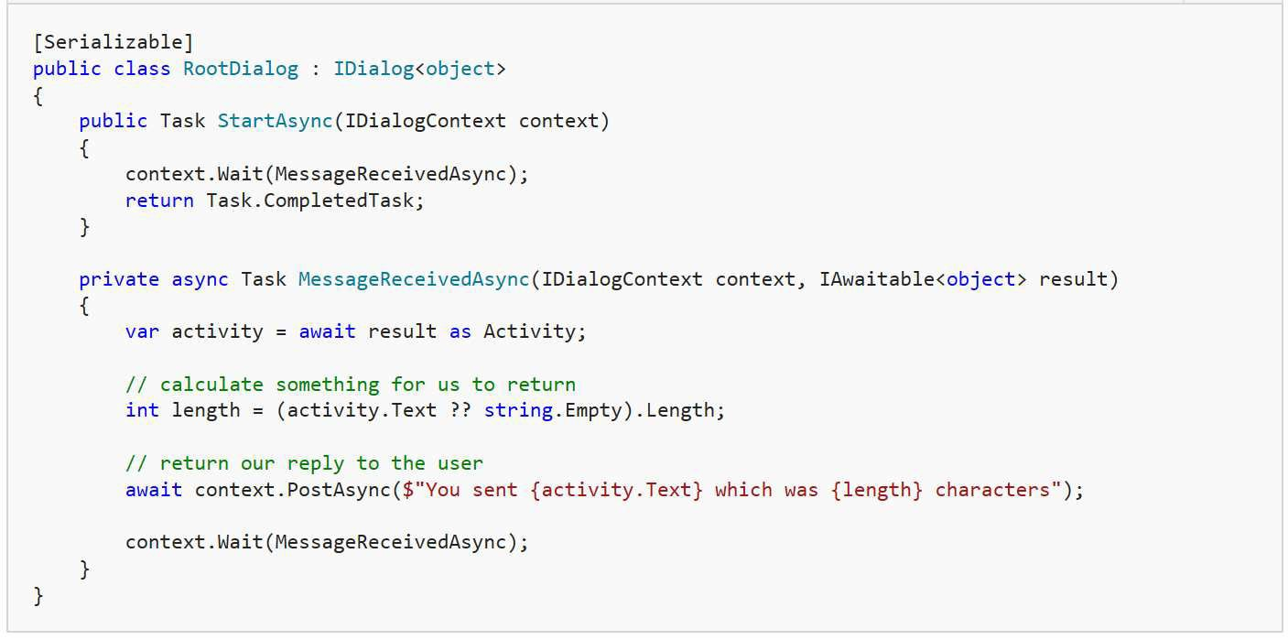
RootDialog

Slide 10
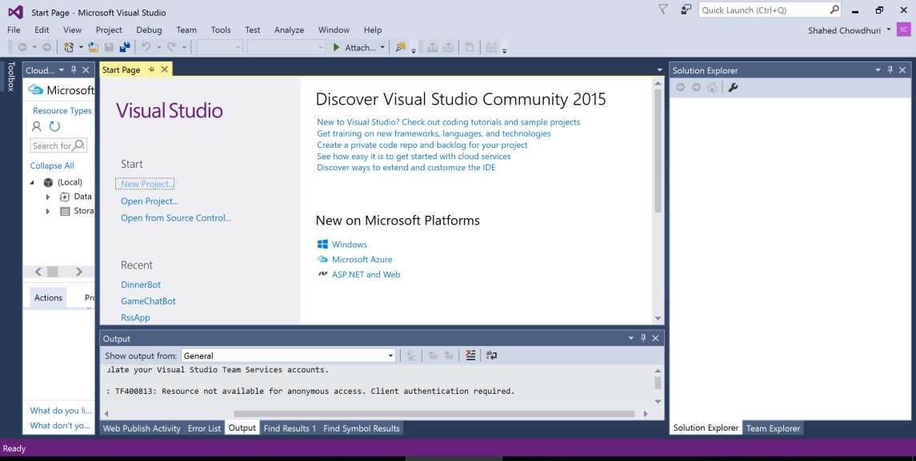
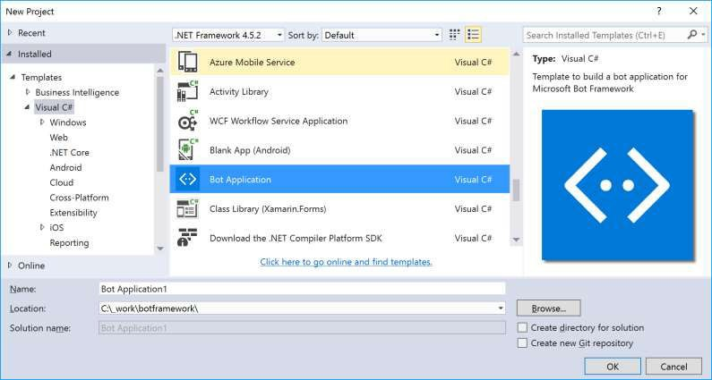
Visual Studio: File | New | Project

Slide 11
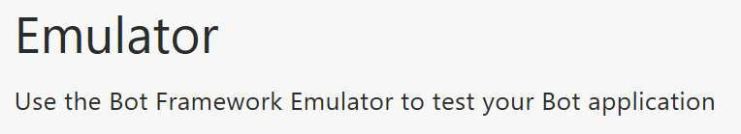
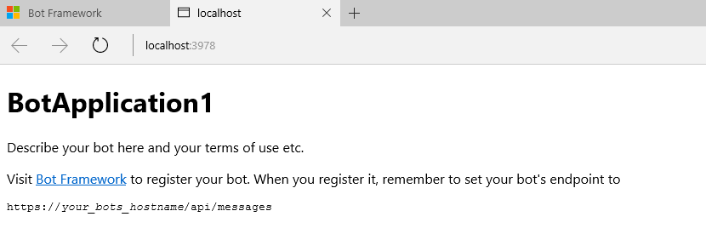
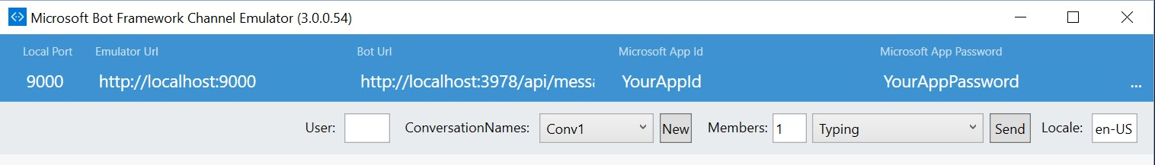
Test Your Bot
Emulator: https://aka.ms/bf-bc-emulator

Slide 12
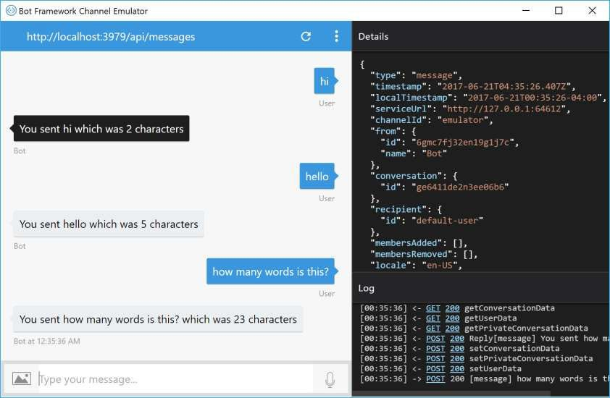
Bot Framework Emulator
Direct Download: https://emulator.botframework.com/

Slide 13
DB Connectivity with Entity Framework
Application Code
Entities in Code
ORM
DB
https://blog.botframework.com/2017/07/26/saving-state-sql-dotnet/

Slide 14
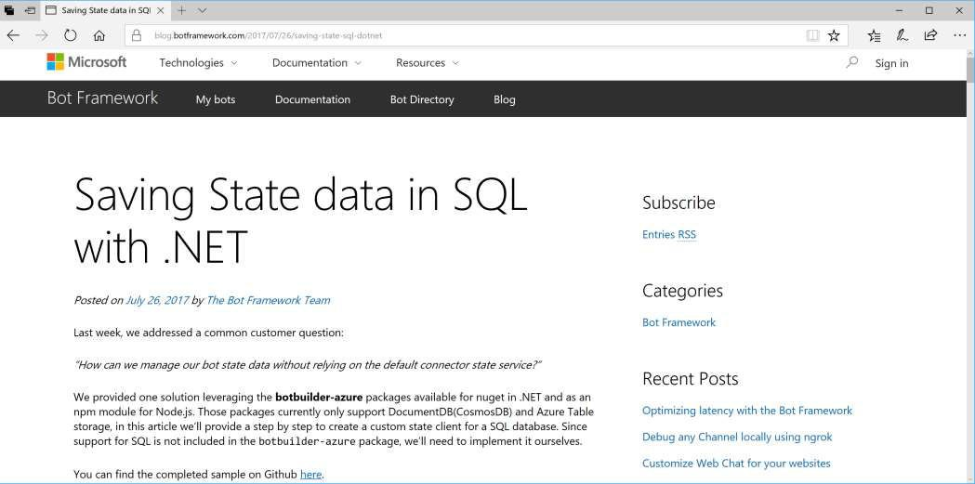
Saving State to SQL Azure
https://blog.botframework.com/2017/07/26/saving-state-sql-dotnet/

Slide 15
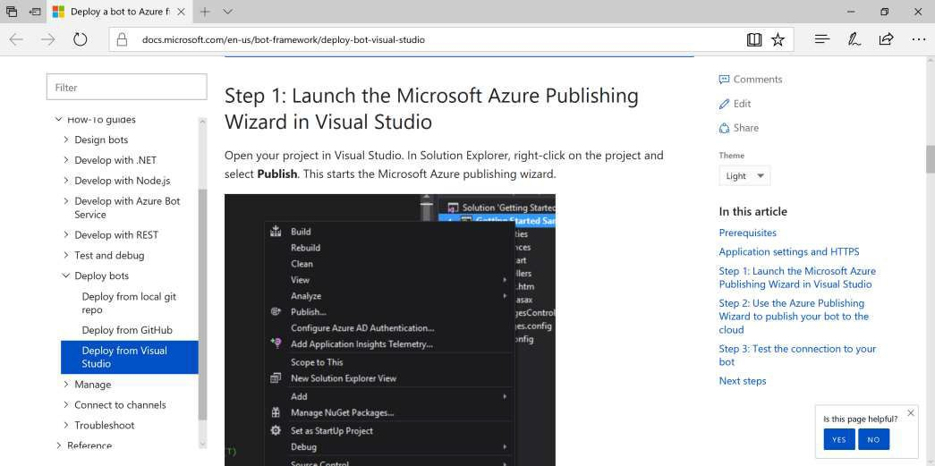
Deploy to Azure
https://docs.microsoft.com/en-us/bot-framework/deploy-bot-visual-studio

Slide 16
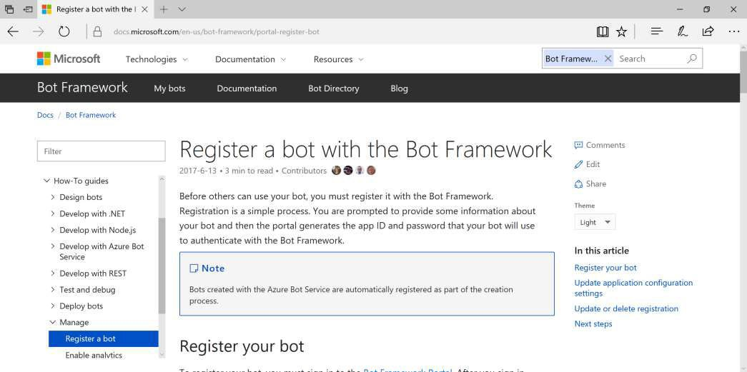
Register Your Bot
https://docs.microsoft.com/en-us/bot-framework/portal-register-bot

Slide 17
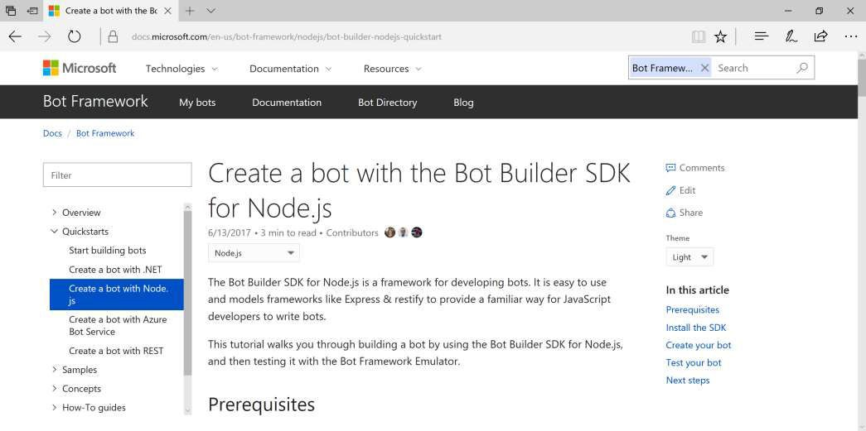
Bot Builder SDK for Node.js
https://docs.microsoft.com/en-us/bot-framework/nodejs/bot-builder-nodejs-quickstart

Slide 18

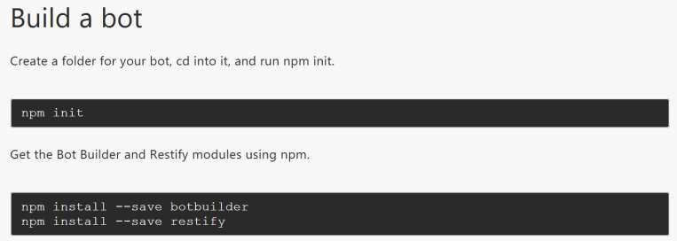

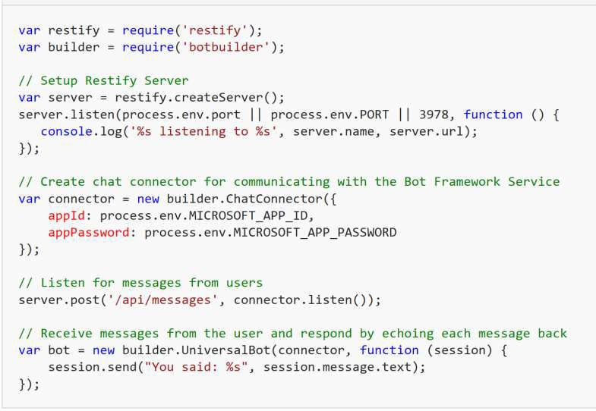
Build a Bot with Node.js

Slide 19
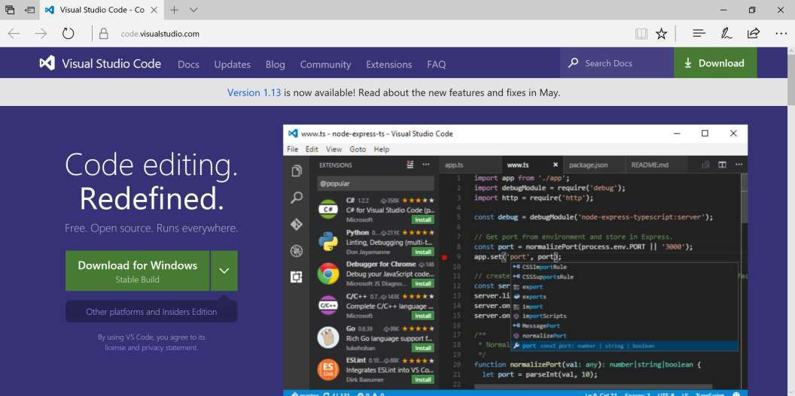
Visual Studio Code
Download: http://code.visualstudio.com/

Slide 20
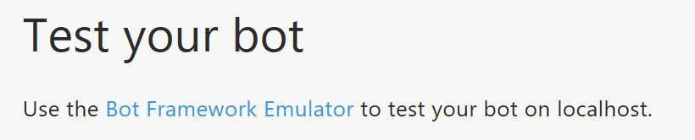
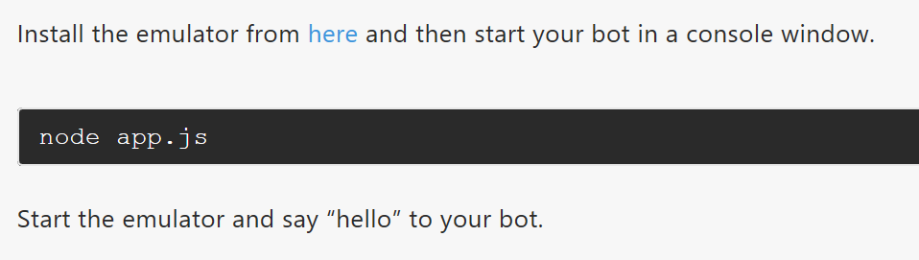
Test Your Bot
Emulator: https://aka.ms/bf-bc-emulator

Slide 21
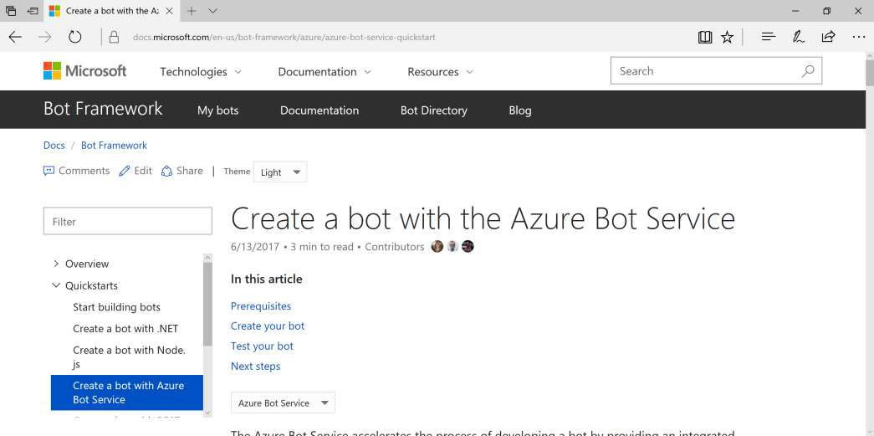
Azure Bot Service
https://docs.microsoft.com/en-us/bot-framework/azure/azure-bot-service-quickstart

Slide 22
Connect & Config

Slide 23
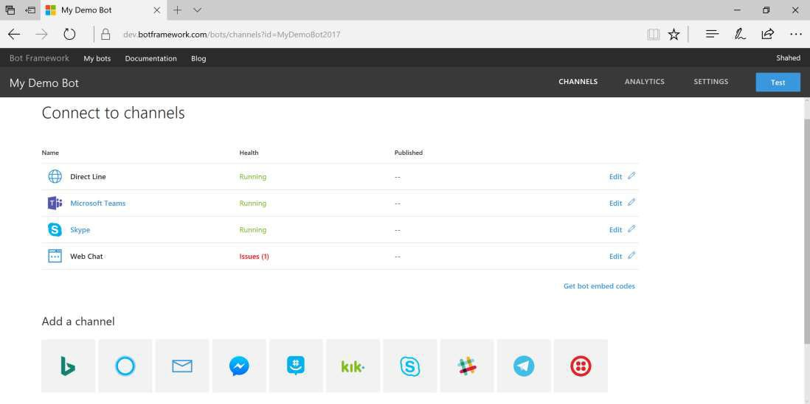
Connect to Channels
Channels:
Email
GroupMe
Skype
Slack
SMS
Telegram
Web
etc...

Slide 24
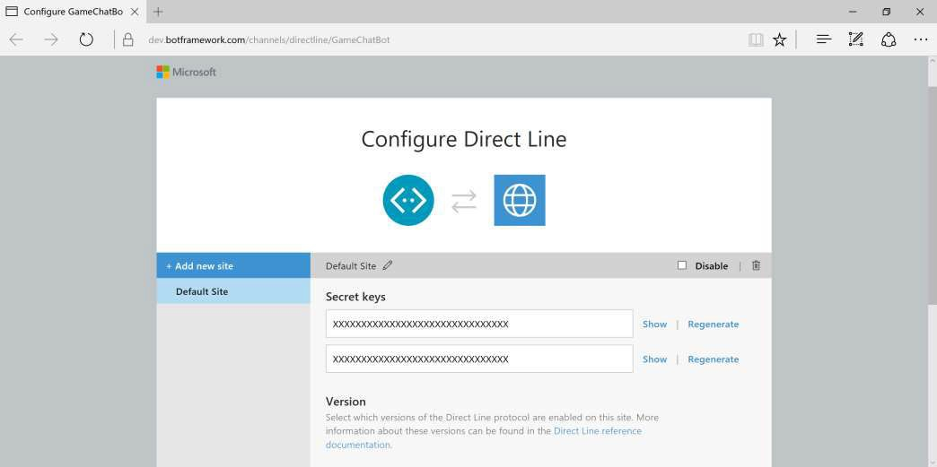
Configure: Direct Line
https://dev.botframework.com/channels/directline/YOUR-BOT-ID

Slide 25
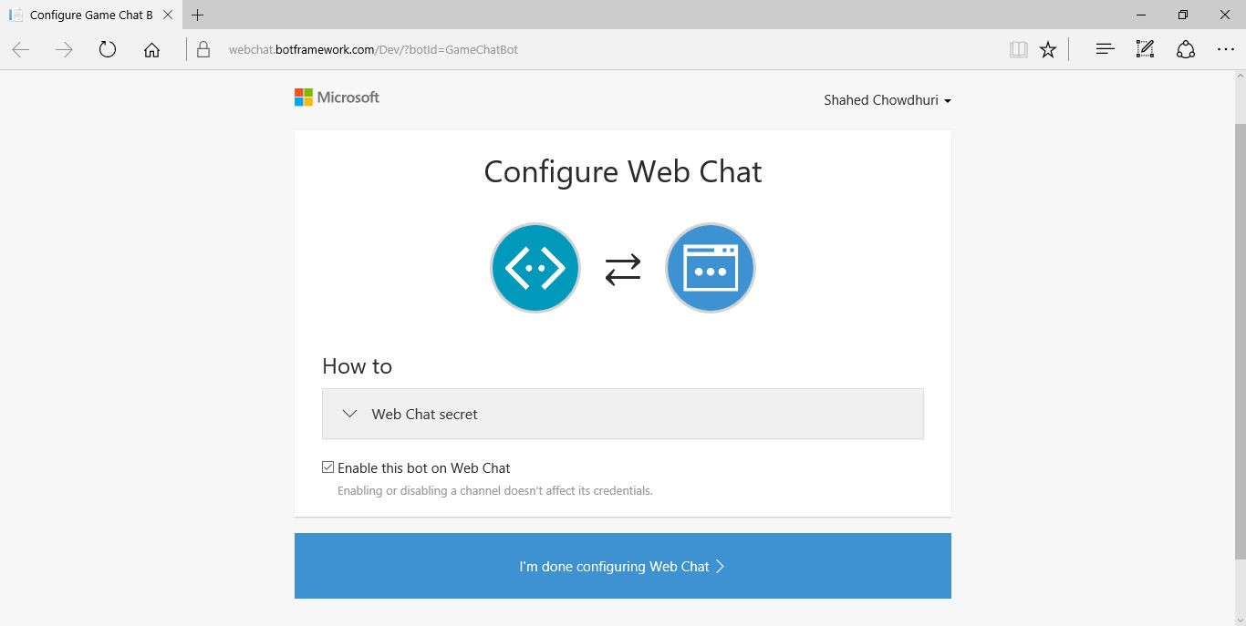
Configure: Web Chat
https://dev.botframework.com/channels/webchat/YOUR-BOT-ID

Slide 26
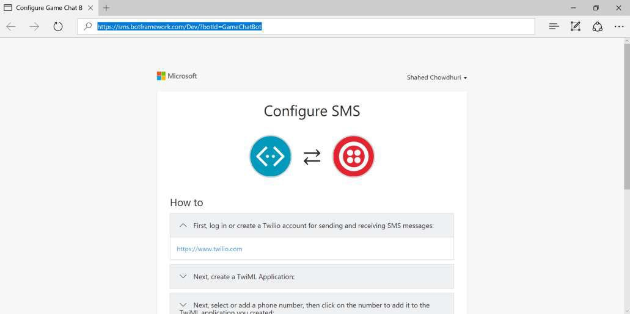
Configure: SMS (via Twilio)
https://sms.botframework.com/Dev/?botId=YOUR-BOT-ID

Slide 27
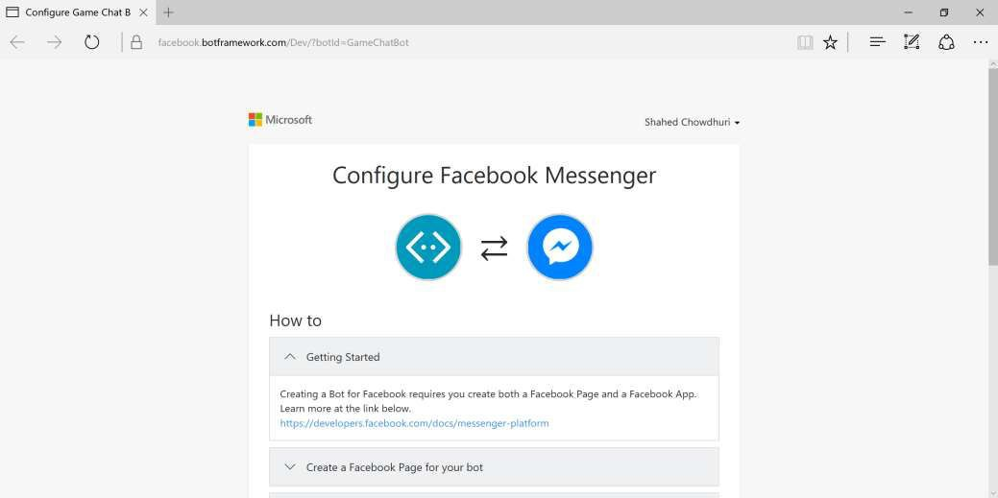
Configure: Facebook Messenger
https://facebook.botframework.com/Dev/?botId=YOUR-BOT-ID

Slide 28
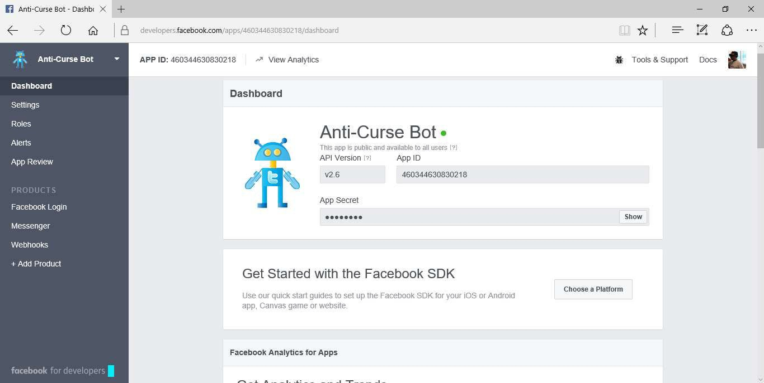
FB Developer Settings
https://developers.facebook.com

Slide 29
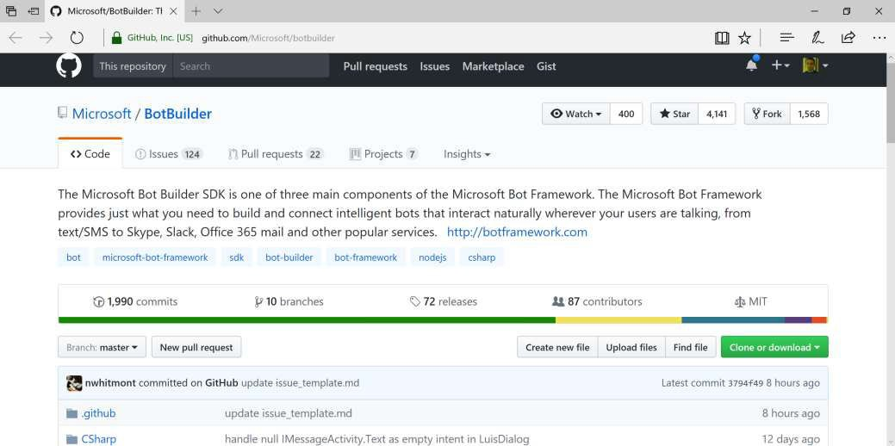
BotBuilder on GitHub!
https://github.com/Microsoft/botbuilder

Slide 30
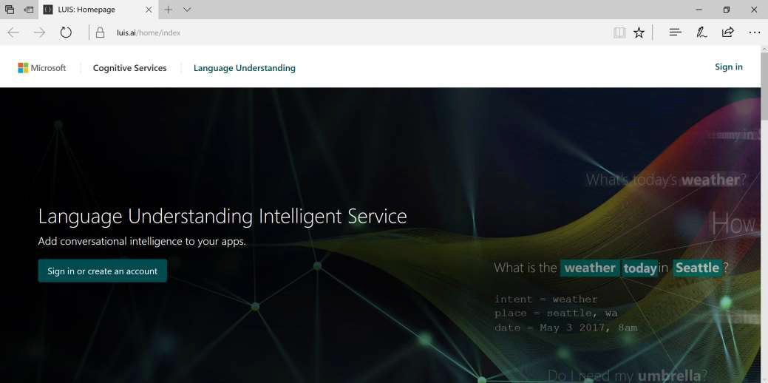
Language Understanding Intelligent Service
https://www.luis.ai/
Help: https://www.luis.ai/Help

Slide 31
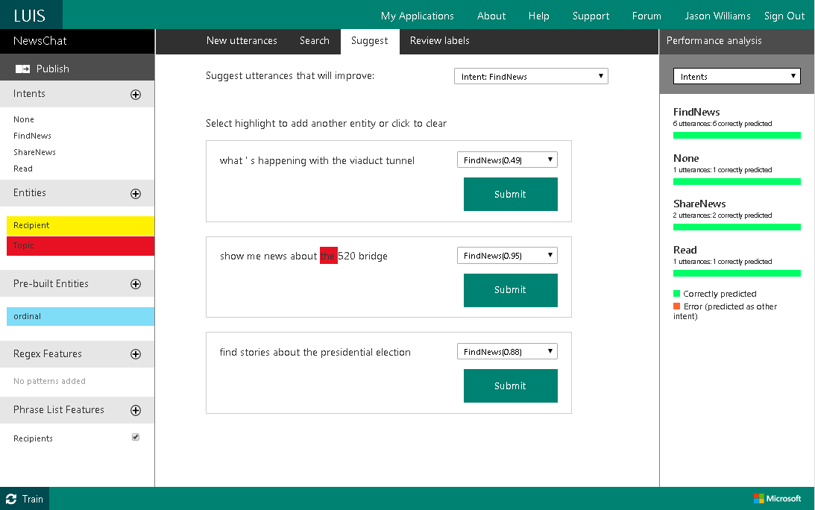
LUIS: Intents, Entities & Labels

Slide 32
Intents in LUIS
Intent: Summarizes the intentions of an utterance

Slide 33
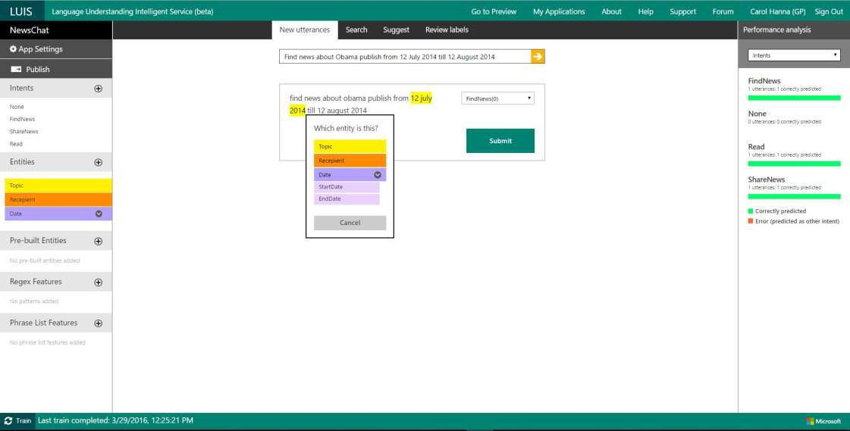
Utterances in LUIS

Slide 34
Entities in LUIS
Entity: Data object that can be pre- built or custom- defined.

Slide 35
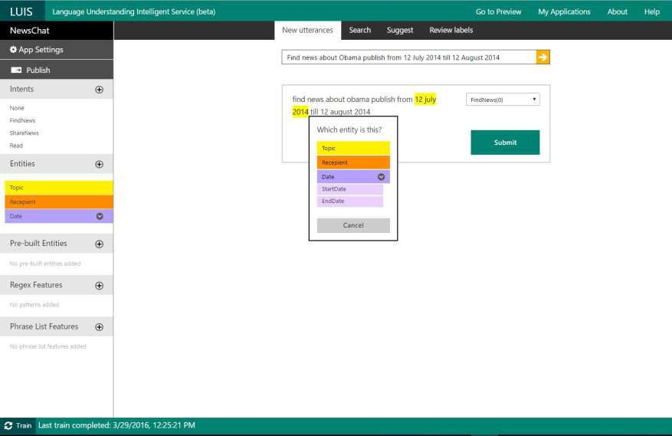
Labels in LUIS
Label: Marked segment of utterance to associate terms with corresponding entities.

Slide 36
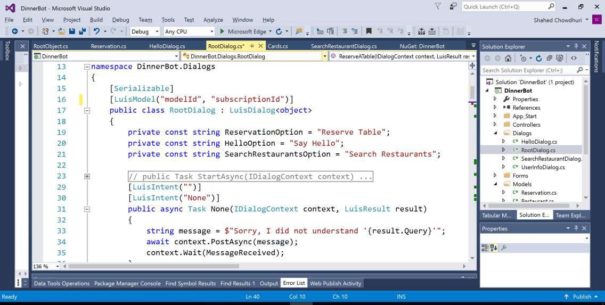
Using LUIS in your Code

Slide 37
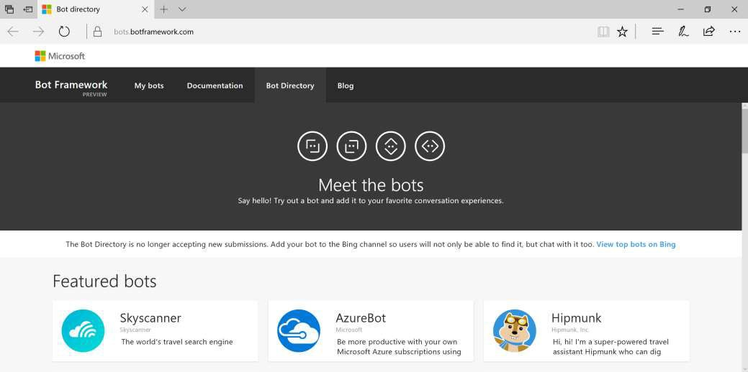
Bot Directory
https://bots.botframework.com/

Slide 38
Demo

Slide 39
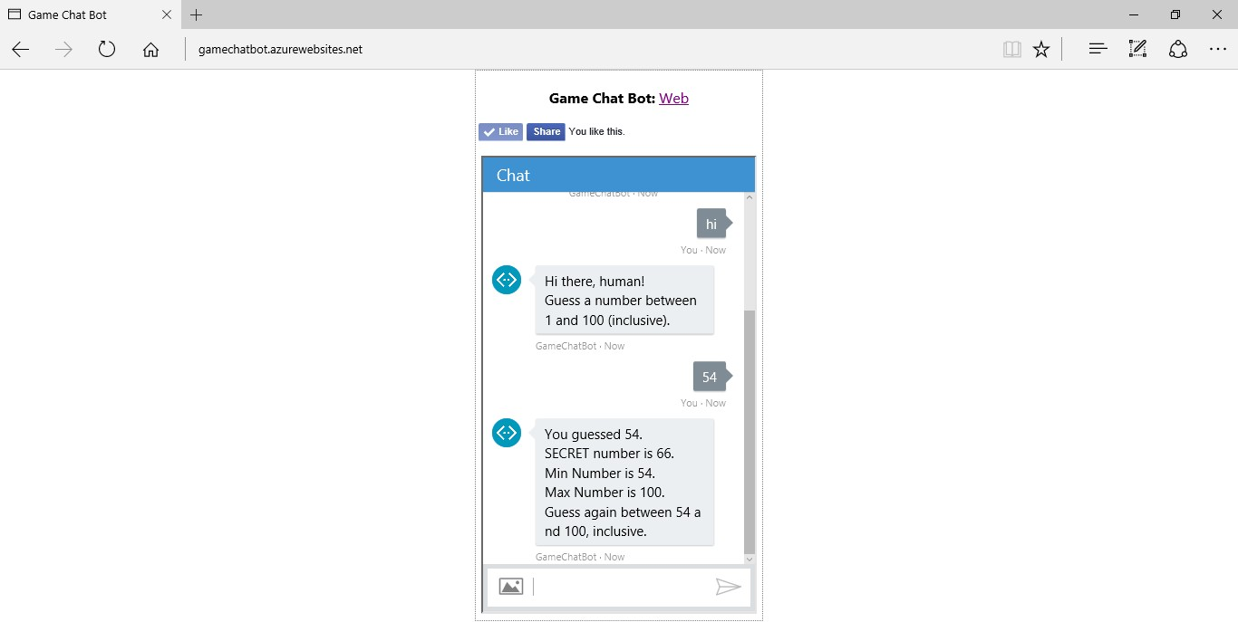
Game Chat Bot
http://gamechatbot.azurewebsites.net/

Slide 40
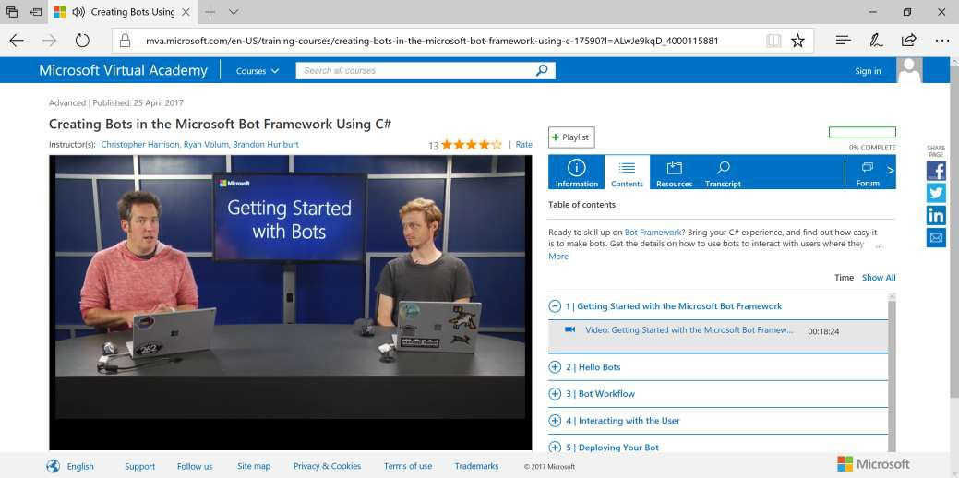
MVA: Bots with C#
Link: https://aka.ms/mvabots-cs

Slide 41
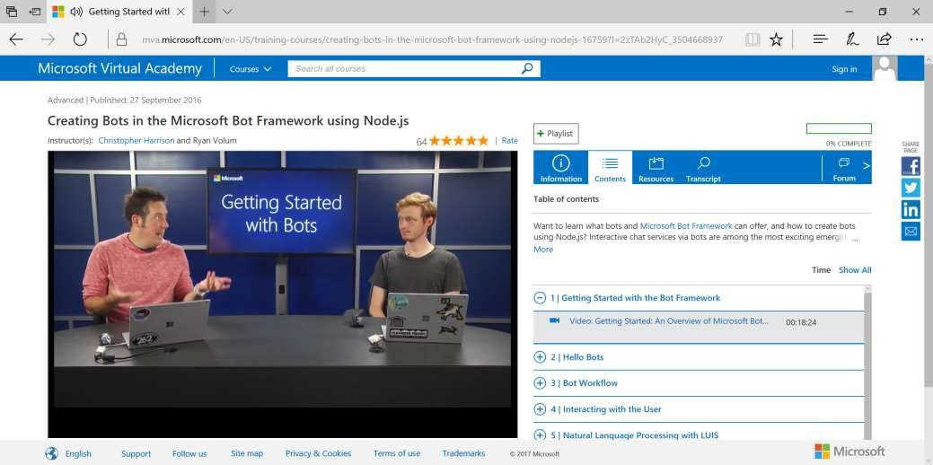
MVA: Bots with NodeJS
Link: https://aka.ms/mvabots-js

Slide 42
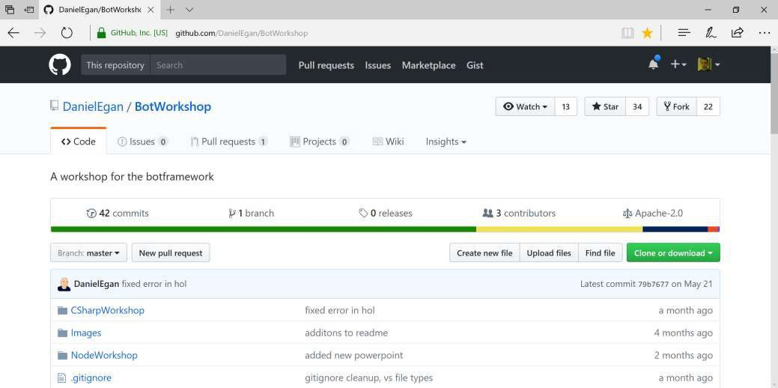
Daniel Egan’s Bot Workshop
Link: https://github.com/DanielEgan/BotWorkshop

Slide 43
Q & A

